Slide 1
Norway
By Jessica Farestvedt

Slide 2
Map of Norway

Slide 3
Flag of Norway
Notes:
Norwegian National Anthem

Slide 4
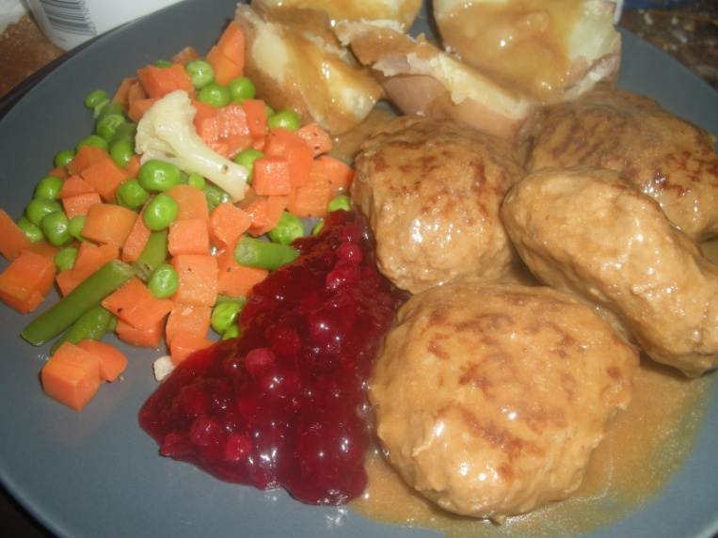
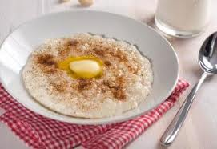
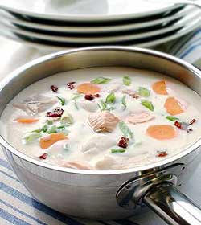
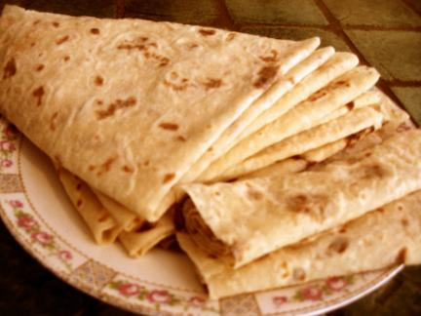
Norwegian Food
Notes:
Risengrot (rice porridge), Lefse (potato tortillas with sugar mixture inside), Fiskesuppe (fish soup), Kjottkaker (meat cakes)

Slide 5
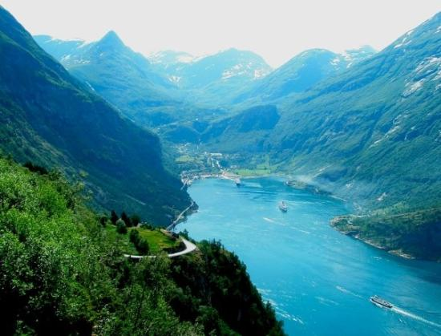
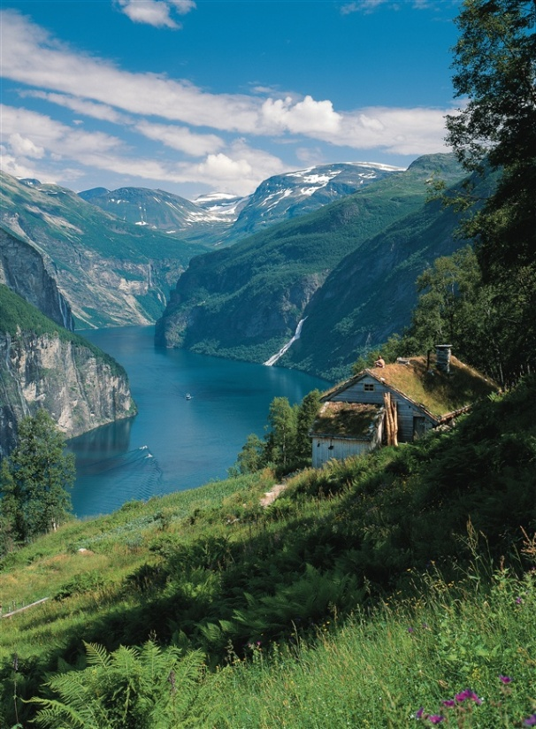
Norwegian Fjords
Norway is known for its Fjords
Big valleys with water at the bottom
Carved out by glaciers

Slide 6
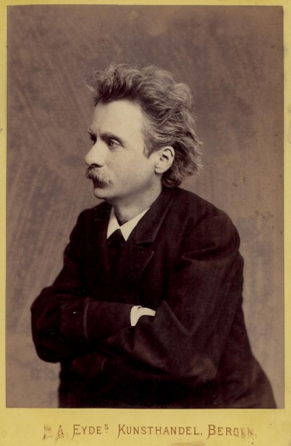
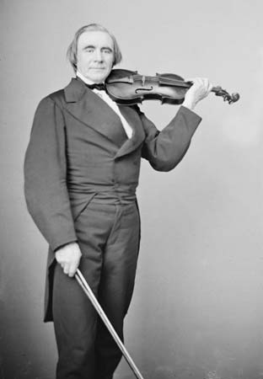
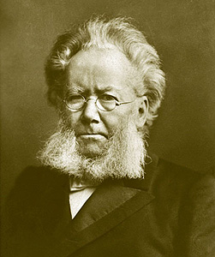
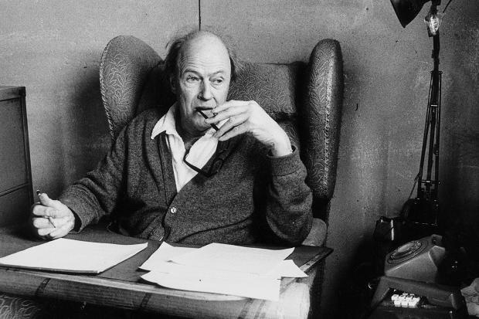
People of Norway
People called “N0rwegians”
Famous people:
Roald Dahl (Author of Matilda)
Henrik Ibsen (poet and playwrite. Wrote A Doll’s House)
Edvard Grieg (Composer- wrote The Peer Gynt Suite)
Ole Bull (Violinist)

Slide 7
Musical Example: Edvard Grieg
Edvard Grieg, Peer Gynt Suite: Prelude: At the Wedding
Notes:
See Lesson Script 1.

Slide 8
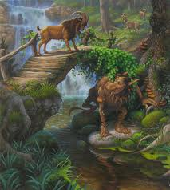
“The Three Billy Goats Gruff”
A Norwegian Folktale
From the collection Norske Folkeeventyr by Peter Christen Asbjørnsen and Jørgen Moe
Notes:
See Lesson Script 2

Slide 9
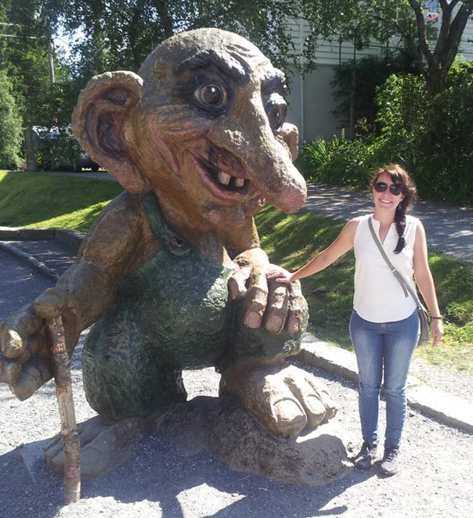
Listening Activity: Pass the Troll
When the music is playing, pass the troll and the goat to your neighbor.
When the music stops, whoever has the troll and the goat stand up.
The troll tries to get the goat as the goat tries to take the troll’s spot.
Remember, only walking and only silent cheers!
Musical Example: Peer Gynt: “Hunted by the Trolls”
Notes:
See Lesson Script 2

Slide 10
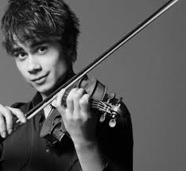
Musical Example: Alexander Rybak
“Fairytale”
http://www.youtube.com/watch?v=uiH4BFTELME
Winner of Eurovision 2009
Folk Music is still important
today. As is the violin.
Notes:
See Lesson Script 3

Slide 11
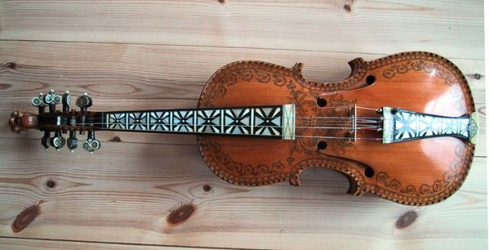
Folk Dance
http://www.youtube.com/watch?v=a_S-IhaEg2o
Seksmannsril (Six man wheel)
Hardanger Fiddle
Notes:
See Lesson Script 4

Slide 12
“Per Spelmann”
Notes:
See Lesson Script 5

Slide 13
Musical Example: Ole Bull
“Et Sæterbesøg” (A Mountain Vision)

Slide 14
Karius and Baktus
Short Film about taking care of your teeth
Two trolls live in Joe’s Mouth
They love to eat candy
http://www.youtube.com/watch?v=VOJo73IGpfE
Eventually they get brushed away.
“Hip Hooray, Hooray, Hooray”
Notes:
See Lesson Script 7

Slide 15
“Hip Hooray, Hooray, Hooray!”
Notes:
See Lesson Script 7

Slide 16
A Closer Look: Lofoten
Henningsvær
Notes:
See Lesson Script 8. Text will be read about Lofoten here- fishing country.

Slide 17
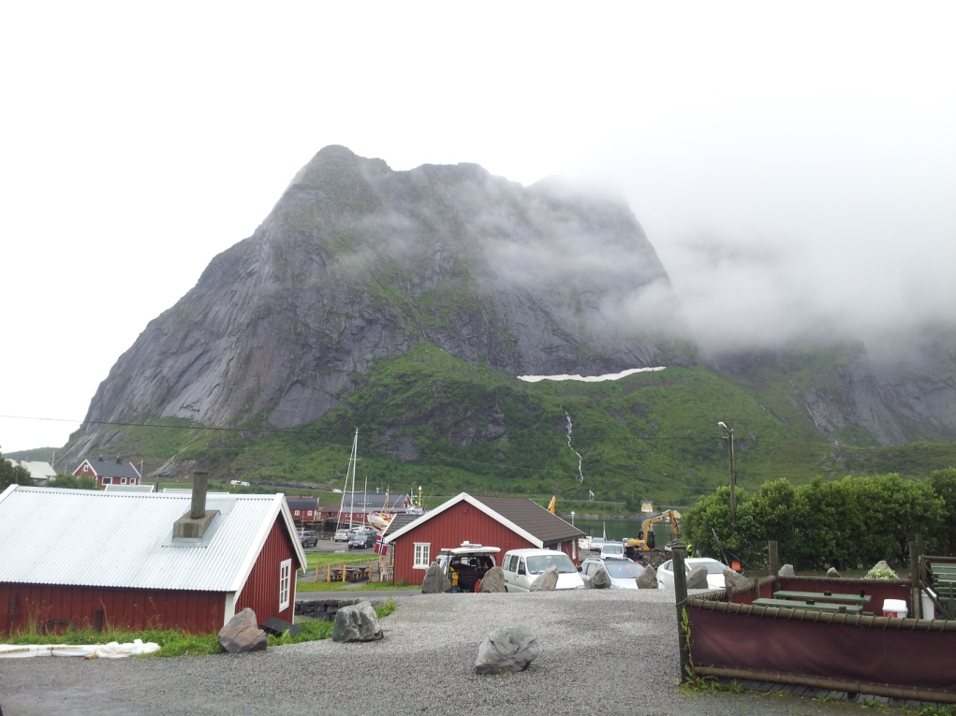
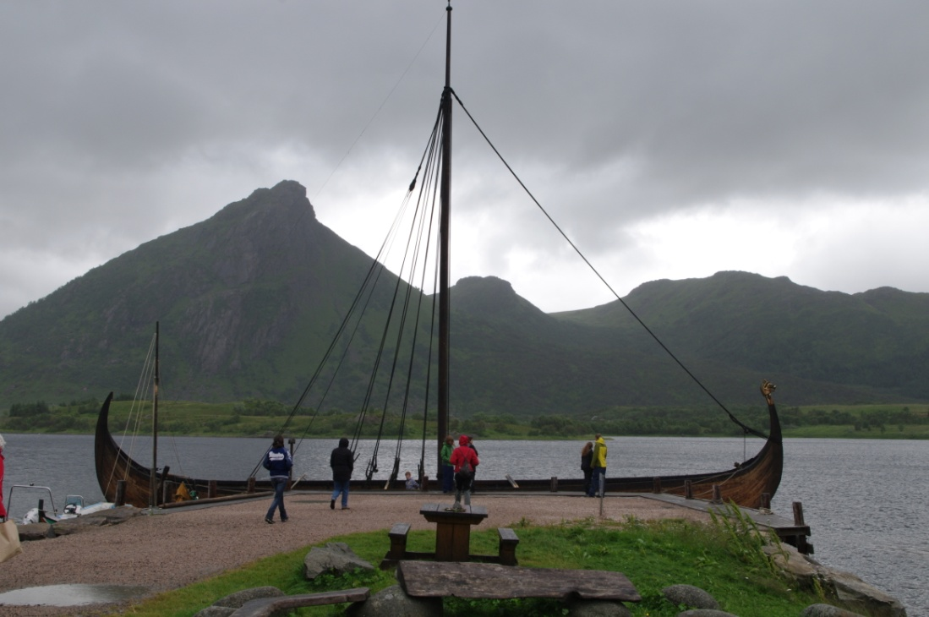
Svolvær and the Viking Museum
Notes:
Pictures of Ms. Farestvedt in Svolvaer in Lofoten.

Slide 18
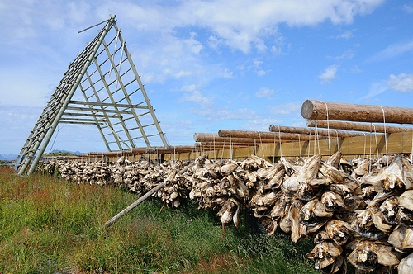
“Lofottorsken”
Norwegian
English
En ekte Lofottorsk jeg er, for jeg er født i Henningsvær. Fadderullan dei, fadderullan dei, fadderullandullan dei. Den gang var jeg et torske-egg, nå er jeg voksen torsk med skjegg. Fadderullan dei, fadderullan dei, fadderullandullan dei.
A genuine Lofoten Cod I am,
for I was born in the Henningsvær.
Fadderullan them, Fadderullan them,
fadderullandullan them.
At that time I was a cod eggs,
Now I am a grownup cod with a beard.
Fadderullan them, Fadderullan them,
fadderullandullan them.
Notes:
See Lesson Script 6

Slide 19
Bibliography
Dahl Jr., Erling. Edvard Grieg His Life and Music. Troldhaugen: Edvard Grieg Museum- Troldhaugen, 2002.
http://griegmuseum.no/edvard-grieg-tidslinje
http://www.britannica.com/EBchecked/topic/84326/Ole-Bull
http://www.britannica.com/EBchecked/topic/280962/Henrik-Ibsen
http://www.gobookee.org
http://www.pitt.edu/~dash/type0122e.html#gruff

